Slide 1
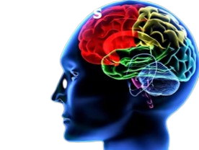
Alzheimer Disease Prediction USING DEEP LEARNING
Group No.- 62
Under the supervision of - | Dr. Krishan Kumar Sethi
Ahmar Hasan Arish | 2006110
Ankit Kumar | 2006115
Vishal Anand | 2006181

Slide 2
Contents
Introduction
Symptoms and Diagnosis methods
How ML can be used in early detection
System architecture
Dataset
Data Pre-Processing
Implementation
Basic definitions
Result Evaluation
Comparison table
Comparison graph
Limitations
Conclusions
Referances

Slide 3
Introduction: Alzheimer Disease
What is Alzheimer’s disease?
A progressive and irreversible brain disorder that affects memory and thinking skills.
The most common cause of dementia, a group of brain disorders that affect cognitive function and behavior.
Usually develops slowly and worsens over time, eventually leading to complete dependence on others for daily activities.

Slide 4
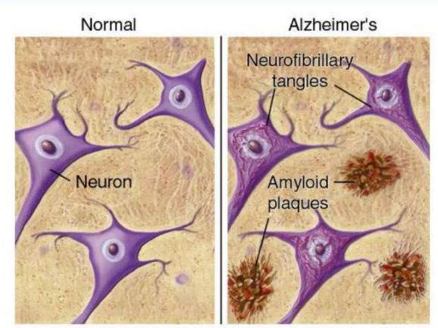
Alzheimer's disease
What causes Alzheimer’s disease?
The exact cause of Alzheimer's disease is not known, but it is believed to be a combination of genetic, environmental, and lifestyle factors.
Environmental factors such as head injuries, exposure to toxins, and poor diet may also contribute to the development of Alzheimer's disease.
One of the main factors that contribute to Alzheimer’s
disease is the abnormal accumulation of beta-amyloid
protein and tau protein tangles in the brain.

Slide 5
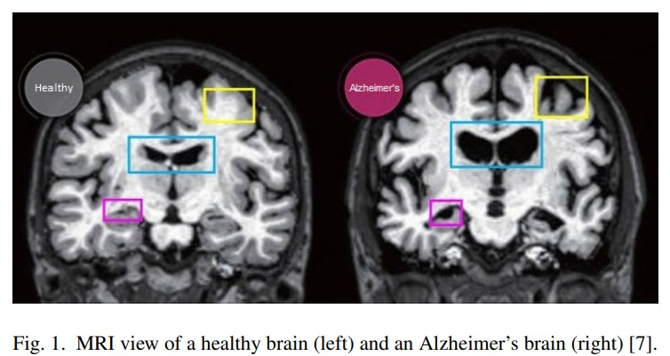
SYMPTOMS
Some key symptoms of Alzheimer's disease:
Memory loss: Forgetting recently learned information or important dates or events is a common early symptom of Alzheimer's disease.
Difficulty with problem-solving and decision-making: Individuals with Alzheimer's disease may have difficulty completing tasks that require planning or making decisions.
Social withdrawal: Individuals with Alzheimer's disease may withdraw from social activities and hobbies they once enjoyed.

Slide 6
Pre-detection of Alzheimer’s Disease
Currently, there is no known cure for Alzheimer's disease.
These symptoms usually develop slowly and worsen over time,
Hence early diagnosis is the most important thing to be done for this disease.
Doctors perform brain scans, such as Computed Tomography (CT), Magnetic Resonance Imaging (MRI), or Positron Emission Tomography (PET), to rule out the other possible causes for the symptom.
This is time consuming and less accuracy making the diagnosis of Alzheimer’s Disease is often difficult, particularly in the early stages. Moreover the diagnosing accuracy mainly depend on the experience of the radiologists.
Thus We can make use of Machine learning to detect Alzheimer's disease.

Slide 7
SYSTEM ARCHITECTURE
Alzheimer's detection using MRI scan
Pre-processing and feature selection
A Machine Learning model
Alzheimer’s
Disease detaction
Performance analysis

Slide 8
Neural Networks
Neural Networks: A type of computer algorithm modeled after the structure and function of the human brain.
It will help us in MRI image processing of a person’s brain.
Following neural networks are considered for image processing in our project-
RNN (Recurrent neural network)
LSTM (Long short-term memory networks)
CNN (convolutional neural networks)

Slide 9
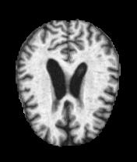
DATASET
We used publicly - available dataset called “Alzheimer's Dataset ” from ADNI available on Kaggle.
Dataset consists a total of around ~5000 images each segregated into the severity of Alzheimer’s classes-
Mild Demented
Very Mild Demented
Non Demented
Moderate Demeneted

Slide 10
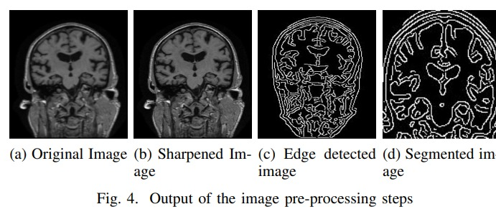
Data Pre-processing
Data pre-processing is a process of preparing the raw data and making it suitable for a
machine learning model. It is the first and crucial step while creating a machine learning
model. It involves below steps:-
Getting the dataset
Importing open-cv libraries and datasets
Converting RGB image to Grayscale.
we divide the pixel values by 255, we are essentially scaling the values down to be between 0 and 1 to normalize the pixel values.
Splitting dataset into training and testing.

Slide 11
Implementation
Once we are done with data pre-processing part , we train our processed data(image) with the help of different neural networks mentioned below.
RNN(Recurrent neural network)
LSTM(Long short-term memory networks)
CNN(convolutional neural networks)
After that we evaluate the performance of different models on the basis of confusion metrics and compare the performance of each alogorithm and plot the graph in each case.

Slide 12
Basic Definitions
RNN:-
Recurrent Neural Networks (RNNs) are a type of neural network architecture that is commonly used in machine learning for tasks involving sequential data. RNNs are designed to process sequences of inputs and maintain an internal state, or "memory," that captures information about the sequence so far.
LSTM:-
It is a variety of recurrent neural networks (RNNs) that are capable of learning long-term dependencies, especially in sequence prediction problems. LSTM has feedback connections, i.e., it is capable of processing the entire sequence of data, apart from single data points such as images.
CNN:-
Convolutional Neural Networks (CNNs) are a type of neural network architecture commonly used in machine learning for image and video recognition tasks. They automatically learn and extract features from input images using convolutional layers, pooling layers, and fully connected layers.

Slide 13
Evaluation
To evaluate the performance of the algorithm ,we have used different matrix which are based on confusion matrix.
Confusion matrix is a tabular representation of a classification model performance of the test set, which consist of four parameters true positive , false positive, true negative and false negative .
 | Predicted true | Predicted false
Actual true | True positive (TP) | False negative (FN)
Actual false | False positive (FP) | True negative (TN)
Accuracy, Precision, Recall, F1-Score are analyzed for different models.

Slide 14
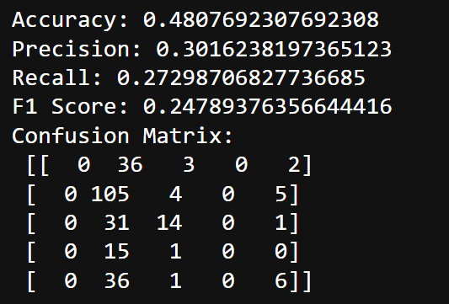
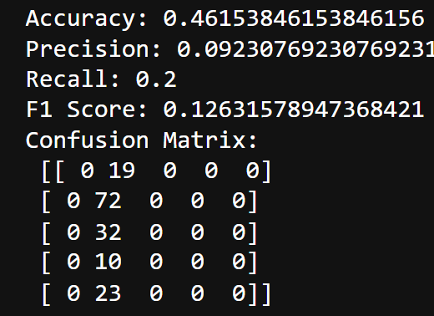
Result – RNN Result - LSTM

Slide 15
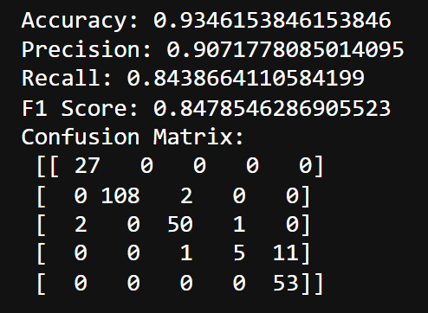
Result – CNN

Slide 16
Comparison-Table
 | Accuracy | F1 score | Precision | Recall
RNN | 0.480769 | 0.24789 | 0.3016 | 0.2729
LSTM | 0.461538 | 0.12631 | 0.0923 | 0.2
CNN | 0.934615 | 0.84785 | 0.90717 | 0.8438

Slide 17
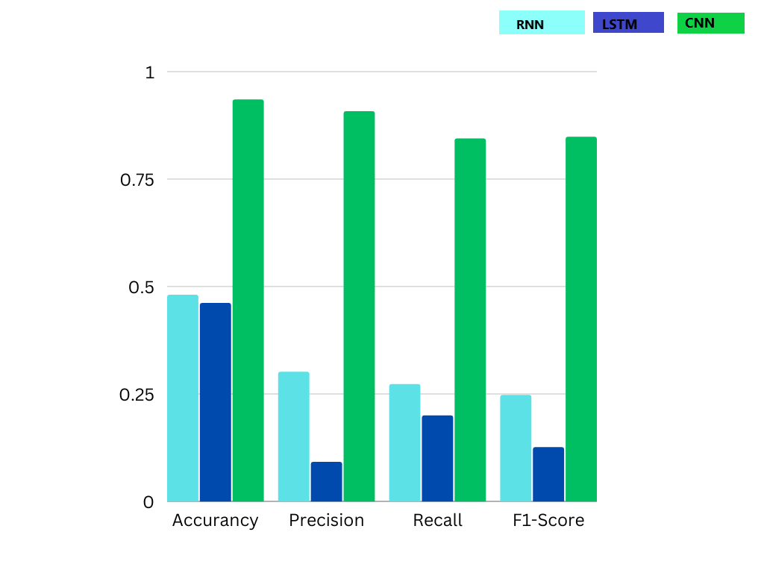
Comparison Graph

Slide 18
Limitations
Computationally intensive: CNNs require significant computational resources, especially during training. Training a CNN can take a long time, and requires a high-performance computer or specialized hardware such as GPUs.
Limited ability to handle sequential data: CNNs are primarily designed for image and video processing tasks, and are not well-suited for handling sequential data such as speech or text. For such tasks, other types of neural networks such as recurrent neural networks (RNNs) or transformers may be more suitable.
Limited ability to handle occlusions: CNNs may struggle to recognize objects in images when they are partially occluded or hidden. This limitation can be problematic in applications where occlusion is common, such as in robotics or autonomous vehicles.
Our system does not guarantee 100% accuracy.

Slide 19
Conclusion
Our observation has shown that accuracy can be improved by introducing dropout layer between dense layer in our model. By introducing a dropout layer with dropout rate 0.25 the CNN model accuracy increases from 94 percent to 96 percent. Dropout is a regularization technique used in deep learning to prevent overfitting.
Simple Recurrent Neural Network(RNN) model was giving accuracy of about 48 percent and LSTM model was giving accuracy of about 46 percent only. The reason could be that RNNs are typically used for sequential data such as time series, speech, and natural language processing. While they can be applied to image analysis tasks, they may not be as effective as CNNs because they are designed to capture temporal dependencies(relationship between data points in a sequence) in the input data, and images do not have an explicit temporal dimension.

Slide 20
Thanks!
References:
Machine Learning and Image Processing Enabled Evolutionary Framework for Brain MRI Analysis for Alzheimer’s Disease Detection
Applying_convolutional_neural_networks_for_pre-detection_of_alzheimers_disease_from_structural_MRI_data
Predicting Alzheimer’s Disease Using LSTM

